Slide 1


CS371 : Artificial Intelligence
July – November 2020
Chapter – 6
Expert Systems and Optimization Techniques AI and ML
Devang Patel Institute of Advance Technology and Research

Slide 2
Expert System Development
Expert systems are used to perform a variety of extremely complicated tasks that in the past could be performed only by a limited number of highly trained humans experts.
Through the application of AI techniques, an expert system captures the knowledge that allows a computer to act as an expert when dealing with complicated problems.
Perhaps, the most intriguing and powerful characteristics of ESs are their capability to deal with challenging real world problems through the combination of processes, which reflect human judgement and intuition.
ESs are being used in wide variety of areas including medical diagnosis, planning, forecasting, design, control, status monitoring and instruction.

Slide 3
Definition of an Expert System
An ES is a computer application (system, software, program(s)) that solves complicated problems that would otherwise require extensive human expertise
To do so, it simulates the human reasoning process by applying specific knowledge and inferences
Internally, an ideal ES can be characterized as including the following:
Extensive specific knowledge from the domain of interest
Application of search techniques
Support for heuristic analysis
Capacity to infer new knowledge from existing knowledge
Symbolic processing
An ability to explain its own reasoning
While solving a problem (the main objective), we are forced to keep note of several constraints

Slide 4
Expert System Development
Before bare knowledge can be used it has to be analyzed. There are many components of knowledge that is the source of the expert’s ability to perform. They may be viewed generally as:
Facts: Statements that relate some element of truth regarding the subject domain. For example..
The power supply output should be at least 200V, for the PC to be switched on. The Figure 200V can only be understood by a person in the electronics/computer field and hence must be supplied by such a person. So, even an otherwise intelligent person will not be able to solve some trivial problem of the powers supply.
“An expert system’s power is derived from extensive domain-specific knowledge.”

Slide 5
Knowledge can be composed of the following three components:
Facts: Statements that relate some element of truth regarding the subject domain. For example,
Measles is caused by phalcipherum.
Procedural Rules : Well defined invariant rules, that describe fundamental sequences of events and relations relative to the domain. For example,
Always check the power supply first before switching on the computer.
Heuristic Rules: General rules in the form of “bunches” or rules of thumb, that suggest procedures to be followed, when invariant procedures are not available or too costly to implement. They are approximate and usually gathered by an expert through years of experience.
The presence of heuristic contributes greatly to the power and flexibility of ESs and tends to distinguish ESs from more traditional software. In addition to these specific forms of knowledge, an expert also has a general conceptual model of the subject domain and an overall scheme for finding a solution. These “global” views form a basic framework for the expert’s application of detailed knowledge.

Slide 6
Architecture of expert system
ESs use a wide variety of specific system architectures, primarily because one architecture will be more applicable than another for a given application. Extensive research so currently in progress to investigate various aspect of ES architecture(s), and considerable debate remains. In spite of differences, most architectures have the several general components in common. The following discussion talks about each of the components.
User
The user of the expert system can be operating in any one of the following modes :
Tester: User attempts to verify the validity of the system’s behavior
Tutor: User provides additional knowledge to the system or modifies knowledge already present in the system
Pupil: User seeks to rapidly develop personal expertise in the field of the subject knowledge from the system
Customer: User applies the system’s expertise to a specific real task
The recognition of the above different roles is in contrast to the more typical recognition of only one role (the customer) for traditional software systems.

Slide 7
User Interface facilities
The user interface facility must accept information from the user and translate into a form acceptable to the reminder of the system or accept information from the system and convert it into a form understood by the user.
Ideally, this consists of a natural language processing system that accepts and returns information in essentially the same form as that accepted or provided by a human expert.
While there are no systems today, which duplicate natural language capabilities, there are several that have demonstrated impressive results through the use of restricted language subsets.
User interface facilities for ESs are often designed to recognize thee mode in which the user is operating,, the level of the user’s expertise, and the nature of the transaction.
Even though natural language dialogue is not fully feasible, the communication with an ES should be as natural as possible in light of the fact that the system is attempting to substitute human behavior

Slide 8
Knowledge Storage and Generation System
The knowledge storage and generation system consists of a knowledge base and in inference engine. It is the heart of the ES. The tasks it has to perform include: safely store expert knowledge, retrieve knowledge from storage and to infer new knowledge when required.
Knowledge Base: The knowledge base represents a storehouse of the knowledge primitives (i.e. base facts, procedural rules, but the specific schemes used for storing knowledge vary greatly. The design of this knowledge representation scheme controls the design of the inference engine, the knowledge updating process, the explanation process, and the overall efficiency of the system.
Inference Engine: ESs, must by their very nature, deal flexibly situations depends upon an ability to infer new knowledge from existing knowledge. As a simple example, of an inference, consider the following two basic facts:
  All animals breathe oxygen
  All dogs are animal
A new fact “All dogs breathe oxygen” can be inferred. To be able to respond appropriately to a particular situation, the ES must apply appropriate knowledge. Applying the appropriate assumes that either the knowledge is present in the knowledgebase or can be inferred from the existing knowledge.
Thus the process of searching for appropriate knowledge and from it inferring new knowledge is a key element of expert system processing.
A question that can be asked is “If the knowledge can be inferred from the existing knowledgebase, why is it not explicitly stored?” The reason is the amount of storage space required.

Slide 9
Time-Space Tradeoff! . The problem with working with very low-level primitives is that even a reasonably small number of primitives can be combined in many different ways to form unique combinations. The number of possibilities quickly becomes astronomical, this problem is called combinatorial explosion. To overcome the problem, most ESS rely on the use of compiled knowledge – knowledge which is expected to be used quite often and generated before hand – rather than attempt to actually operate from primitives.
The inference engine is the software that locates knowledge and infers new knowledge from the base knowledge. The engine’s inference paradigm (strategy) is the search strategy that is used to control the search process (to acquire new knowledge). The two most popular strategies used are: backward chaining which is TOP-DOWN reasoning process (because you already know the goal state) that starts from the desired goals and works backward towards the desired goals and works backward toward requisite conditions, or forward chaining, which is a BOTTOM-UP reasoning process that starts with the known conditions and works towards the desired goal. Obviously, the selection of the inference paradigm, with consideration for combinatorial explosion, strongly influences the overall performance of the ES.

Slide 10
Knowledge Update
It is possible that the knowledge currently stored in the knowledgebase, is outdated. This is because the knowledge in many complex domains is constantly expanding and changing and hence the knowledge base must be modified correspondingly. The knowledge update facility is used to perform such updates. This can be done by three methods as described below:
The first form is manual knowledge update. In this case the update is performed by a KE who interprets information provided by a domain expert and updates the knowledge base by using a limited knowledge update system
In second form, which represents the state f the art in ESs, the domain expert enters the revised knowledge directly, without the KE’s mediation. The knowledge update system, in this case must be much more sophisticated.
In the third form, machine learning, now knowledge is generated automatically by the system and is based on generalizations drawn from past experience. The system, in effect, learns from experience, and so ideally is self-updating. This particular aspect is a subject of present research. Ideally the modification of the knowledge base should be independent of inference engine, but rarely it is possible to implement it so.

Slide 11
Explanation System
Humans will be quite unwilling to use the result of a program, which they cannot reason about. Hence, if required, the ES should explain the reasoning steps that led to a particular conclusion.
The explanation facility typically consists of an identification of steps in the reasoning process and a justification for each step. It is required to somehow communicate these steps in an intelligible and acceptable manner to the end user.
The credibility afforded to an ES reasoning process. It is important for the entity providing the explanation to match the explanation level or detail with the person using the explanation.
For example, an airline pilot might announce to his passengers “The flight was terminated because of technical difficulties”. To another pilot, it might be a complete technical explanation, the system must recognize the user’s level of expertise and understand how to tailor the explanation so that it will best serve the invoker’s needs.
The explanation system in current system is simply restricted to the rules, which matched.

Slide 12

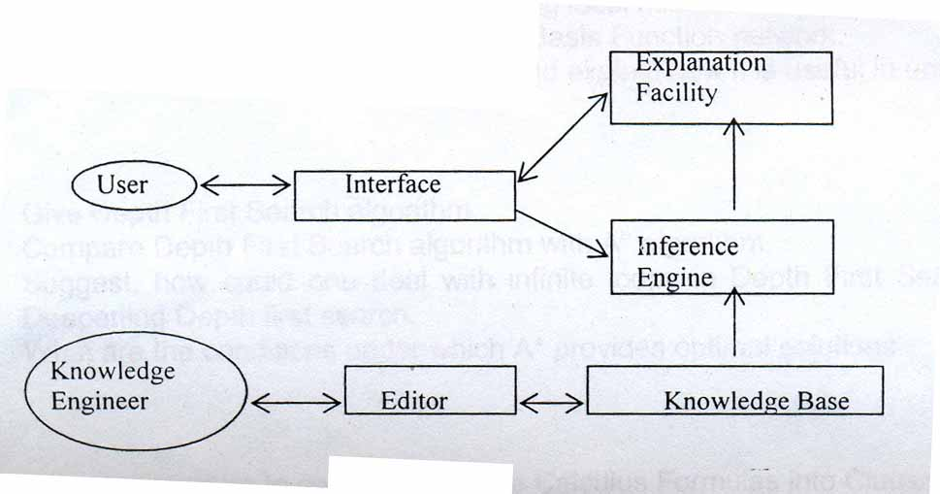

Slide 13
Development process
Several of the standard software development process steps are common with the ES development steps, these steps consist of formalization, implementation, evaluation.
System development is to establish that the proposed problem is suitable for and requires an ES solution. If the problem at hand can be defined by direct definitions and algorithms, it probably better solved by traditional methods. If it is ill defined or probably requires intensive human judgment, it is probably too complex for ES
The next step is to express the problem accurately and formally. Then follows the design of the expert system. After the design, we go to implementation. The evaluation phase, which follows implementation, is intended to evaluate the extent to which the system approaches the expert’s behavior and whether it responds appropriately in situations for which it is not explicitly programmed.

Slide 14
THE EXPERT SYSTEM DEVELOPMENT PROCESS
As with any large software project one should keep in mind the flowing programming paradigm, when implementing the expert system” when complexity increases beyond a certain level, design is more important than implementation”. ES generally follow the model. The ES life cycle is based on the recognition of evolutionary nature of software development.
Expert system problems are poorly defined initially and not so well understood. There are several distinguishing features of the ES model:
  The customer (and the domain expert) is involved throughout the entire process. This Is in contrast with traditional system, in which the user specifies requirements and only receives the final product.
  Frequent demonstrations of the work are encouraged. This demonstration allows the customer and expert to visualize the functioning of the completed system and request changes so that the product meets the customer’s requirements. The expert system lifecycle consist of following:
    Problem selection
    Prototype construction
    Formalization
    Implementation
    Evaluation
    Long term evaluation

Slide 15
Problem Selection
During the problem survey phase various aspects of the problem considered for expert system implementation are analyzed. During the first step of problem selection a variety of problem types and areas are considered. Out of the various areas considered for expert system implementation, one has to select or narrow the list to application, which will receive serious consideration. Hence we should have screening criteria. Only the areas i.e. applications that meets almost all the screening criteria advanced to the candidate list the following are the basic screening criteria:
  Does the task require the use of expert knowledge?
  Is the require expertise scarce?
  Are experts who know how to perform the task available?
  Is there some reason to believe the tradition algorithmic solution would be difficult to implement?
  Does the task require the reasonable amount of judgmental knowledge or dealing with some degree of uncertainty?
  Is the solution to the problem economically rewarding? Will it affect the financial condition of the organization?
  Will the solution stay valuable for enough period of time?
  Do we allow some optimum response in some (hopefully rare) situations?

Slide 16
Domain Applicability
This step is more detailed analysis of the suitability of the domain for ES. Application. Criteria for this analysis include The task require scarce expert reasoning there is enough evidence to establish their knowledge in this area might be scarce.
  There is a wide gap between the levels of performance of the expert practitioner and the typical practitioner
  There is a need to formalize a complicated set of informal procedure that are clearly understood by a only a few experts.
  There is a need to preserve the knowledge that may be lost.
  There is a need to distribute expertise to many locations.
  The experts are in short supply and are not easily available.
  There are frequent occasions when several people have to work together to solve a problem because no single person has the require expertise.
  There is a large volume of complex information that must be used to solve a problem.
It is obvious that an appropriate domain expert is available for any expert system project to succeed.

Slide 17
Prototype Construction
Once the problem domain has been selected, the next task is to construct a prototype that represent a small part of the final system. It will typically address five to ten test cases and will require a few weeks to a few months to complete, depending on scope and difficulty of the problem. The steps in this process are:
  Initial knowledge acquisition
  Basic problem approach
  General consultation model
  Inference paradigm selection
  Knowledge representation
  Representation selection
  Prototype implementation
  Prototype testing
  Prototype demonstration
  Project revision

Slide 18
Prototype Construction
The primary purpose of the demonstration prototype is to learn more about the domain. The prototype construction relies on the best available knowledge at the time and subsequent revision if better or more accurate knowledge is obtained. The specific purpose for building the prototype are three fold:
  To gain a deeper understanding of the nature and scope of the problem and associated problem solving techniques.
  To demonstrate the overall system functionality. This allows the customer to evaluate the usefulness of the system and to decide whether to continue with the development of the entire system. (In effect it is the last step in deciding whether to implement an expert system for this domain)
  To test the initial design decisions.
The prototype construction activity usually involves the knowledge engineer (KE) and the domain expert. It begins with initial knowledge acquisition. All available sources of knowledge are utilized and then the KE sits down with the domain expert to discuss specific case studies and clarify the KE’s understanding of the domain.
After the KE has understood the problem domain, the process of developing a basic problem approach, general consultation model, inference methods and knowledge representation begins. The best way to implement a prototype is to put down your best understanding, even if it is wrong, and then criticize and review it.

Slide 19
Formalization
After the verification of the prototype, work on the final system begins in the earnest. The next major task in the development process is the formalization process. The primary purposes of formalization are to:
  Capture and record the key understandings that were developed during the prototype phase.
  See to it that the entire project is planned before the implementation begins.
  Record decisions with regard to implementation strategies.
  Provide visibility to all current understandings to allow more people to contribute to the project.
  Provide visibility and checkpoints to allow for the management of the project and allow the user to be involved in the project.
  Allow for the concurrent development of test, deployment, long-term support facilities.

Slide 20
Implementation
The steps in the implementation phase are:
  Prototype revision
  System framework development.
  Core knowledge acquisition.
  Ancillary software development
  Internal integration
  Internal verification
The prototype revision process consists of the following steps:
  Revision of representation and the inference domains
  Component representation level revision
  Establishment of knowledge base partitioning
  Verification

Slide 21
In the first step the knowledge representation scheme and the inference scheme are modified to comply with the decisions made during the design phase. Following this the overall scheme for assigning knowledge primitives is reevaluated. This involves reviewing the representation level, object selection, and the attributes associated with those objects.
For example, in prototype development the KE may have decided that several parts should be viewed as an assembly and so were represented as a single object in the system. A component evaluation might reveal that the selected representation level is too high; greater flexibility might result from representing such characteristics individually. This reevaluation is based on the clearer understanding of the domain that results from the prototype development activity and from the fundamental revisions to the representation and inference scheme that occur during the design phase.
Knowledge Base Partitioning makes it easier to change the knowledge base because the base is divided into logically independent segments rather than being one large entity. An effective technique for dealing with complexity is to decompose the system into manageable bits.
Partitioning can be approached at an architectural level-for example, by dividing the task into independent sub-problems or by using separate knowledge bases within one system. Some concepts are important to developing a scheme for partitioning within a knowledge base.

Slide 22
Cohesion: The extent to which different knowledge “chunks” within a knowledge base segment are closely related (i.e. how well the parts of a segment “stick together”)
Coupling: The number of connections between segments.
Partitioning Base: The characteristics that are used for grouping chunks into segments. To partition the knowledge base, the KE first selects a Partitioning base and then groups chunks according to the following principle:
Knowledge chunks should be so grouped that cohesion is maximized and coupling is minimized.
After the prototype functionality has been implemented by using the selected representation and partitioning techniques, it is verified. Following the revision of the prototype, the largest development phase begins. This phase includes the implementation of the basic framework for the system (i.e. inference engine, user interface etc.), the core knowledge base, and any ancillary software required, these activities can generally be executed in parallel. The core knowledge is comprised of the knowledge required to complete the test plan.

Slide 23
As a first step in this process, the KE acquires the knowledge from the expert. The KE then enters the new knowledge into the knowledge base. This entry follows the architectural design and the knowledge base partitioning plan and is accomplished through the use of the appropriate knowledge base construction tools.
The new knowledge must be integrated with the old knowledge. The two biggest challenges in this process are determining whether the knowledge to be added is already present in the knowledge base in a slightly different or more general form (in which case it should be subsumed by the more general knowledge) and ensuring that the new knowledge is consistent with the existing knowledge.
When knowledge is added, the existing functionality must be chocked for regressions (dependency of one variable on another).

Slide 24
If regressions are discovered, the knowledge base is again modified and the test cycle restarted. Following the successful completion of these tests, the case information for the new case is saved and the knowledge acquisition phase continues.
The ancillary software (i.e. communications, utilities, database connections etc.) is developed in parallel with the system framework and by using traditional software developmental techniques.
Internal Integration and Verification
The various components of the system must be integrated into one cohesive unit. This may require resolution of conflicts between various modules, generally a result of misunderstanding of interface conventions. Then the KE and the domain expert verify the system, by taking representative test cases.

Slide 25
Evaluation
How do we go about evaluating an ES? There are certain difficulties involved:
  The first difficulty encountered in structuring as ES test is a result of the following:
    For many of the domains addressed by ES, it is impossible to identify an answer that is “absolutely correct” for any given problem. Obviously in ES evaluation the correct response is taken to be that given by a human expert for the same question. Even human experts fail. No doctor can claim to have diagnosed all diseases with 100% accuracy. Thus an ES’s responses should be evaluated relative to the domain experts and then relative to the responses given by a group of experts. It is also possible to test the consistency of the system.

Slide 26
Knowledge Acquisition
Knowledge Acquisition is a “bottleneck” in implementation of ES.
Subject Expert - Knowledge Engineer Interaction:
The KE’s knowledge, rather than the subject Expert’s knowledge is actually reflected in the ES.
Thus KE must be very careful in accurately modeling the Expert’s knowledge.
This is done by a series of meetings with the Expert, starting with an initial meeting with the purpose of domain understanding. The subsequent steps are:
  Sample problem identification
  Sample problem implementation
  Prototype implementation
  In-depth critical analysis
  Full implementation
Because this involves human interaction, the KE should remain sensitive to continued personal relationship with the expert.
  Never ask the expert for some basic information that could be acquired through background reading.
  Whenever possible, the KE should use the language of the domain when working with the expert.

Slide 27
Cognitive Behavior of Experts:
  Experts frequently do not follow textbook-like lines of linear reasoning.
  Experts knowledge is stored subconsciously and thus it is generally difficult for him to explain his problem solving actions;
  Experts often find it harder to explain their actions and thinking than the novices do.
KA Techniques:
  Description: Expert presents a structured description of the Domain. This is good for establishing the background information. But it has limitations, as it does not contain the problem solving strategies.
  Observation: The KE simply and unintrusively watches the expert during a problem-solving situation. This is very useful once the KE has reasonable level of competence in the Domain.
  Introspection: Occurs while the KE is interviewing the Expert, a critical assessment of the problem-solving situation is conducted. This allows the KE to interactively search for the required knowledge.

Slide 28
Use of multiple Experts:
To identify possible errors in the present ES. But it is generally required that the KE be acquainted with the Domain very well before this can be attempted.
Expert System Tools:
  Provide a rich software development environment
  Assistance in rapid prototyping
  Facilities for:
    Defining a consultation model
    Knowledge representation
    Inference paradigm
Allows someone who is not very familiar with AI concepts to develop a system.
Provides a solid basis for quick capture of knowledge and rapid ES development
Eliminates the labour involved in building the basic software.

Slide 29
Languages for ES development:
LISP (Especially CommonLisp)
PROLOG (has built-in search method)
FORTRAN (several important ES in the past have been developed using it)
C (lack of support for symbolic processing and automatic memory management but runs much faster compared to LISP or PROLOG, many more proficient C programmers are available compared to LISP or PROLOG)
To achieve the best of both worlds, many developers use the following rule:
Consider developing the system by using a symbolic language and converting the final version.

Slide 31
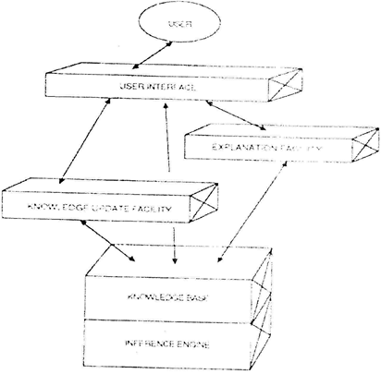

Slide 32

GENETIC ALGORITHM
EVOLUTIONARY PROCESS

Slide 33
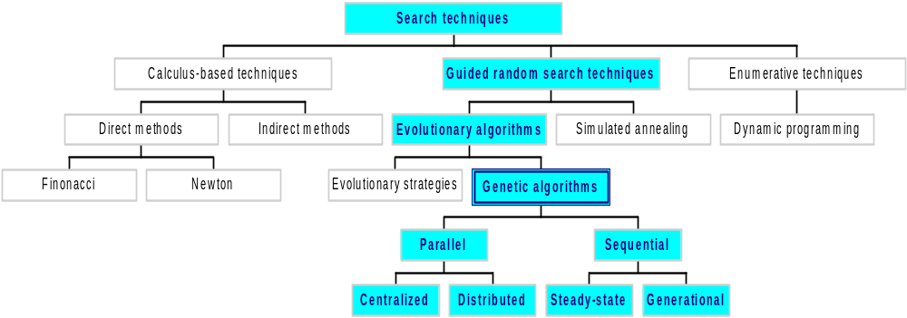
Classes of Search Techniques

Slide 34
Need Analysis
There is always a need of better Search and optimization technique in every field. But, there are very few methods that work better and faster over huge bulk of information.
The field of Genetic Algorithm is relatively untouched. Even its power is still not exploited in a proper fashion. Genetic Algorithms guarantees faster and better access to huge information in a very robust manner.

Slide 35
Objective And Scope
To find an optimal solution to a problem.
Since GAs are heuristic procedures, they are not always guaranteed to find the optimal solution,
But they are able to find very good solutions for a wide range of problems.

Slide 36
GAs Continue…
The goals of GA
To abstract and rigorously explain the adaptive process of Natural Systems.
To design artificial systems software that retains the important mechanism of natural selection.
Central theme
Robustness
Adaptation

Slide 37
Genetic Algorithm
Why Genetic Algorithms (GAs) ?
  Many real life problems cannot be solved in polynomial amount of time using deterministic algorithm.
  Sometimes near optimal solutions that can be generated quickly are more desirable than optimal solutions which require huge amount of time
  Problems can be modeled as an optimization one.

Slide 38
Genetic Algorithm
Randomized search, optimization and machine learning technique
Based on the mechanics of Natural Selection and Natural Genetics.
Darwinian natural selection: only those organisms survive and reproduce which are fit for their environment.
Can also solve NP-hard problems.
The algorithm is so versatile that it can be used in any field.

Slide 39
What are NP-hard Problems?
Any Problem that involves the identification of an optimal(min/max) value of a given cost function is known as optimization problem.
Algo. with property “the result of every operation is uniquely defined”-are termed deterministic algo.
A problem is NP-hard if and only if satisfiability reduces to problem
The satisfiability prob. is to det. whether a formula is true for some assignment of truth values to the variables.

Slide 40
Continue..
Examples of difficult problems, which cannot be solved in “traditional” way, are NP problems.
But there are many important tasks, for which it is very difficult to find a solution, but once we have it, it is easy to check the solution. This fact led to NP-complete problems.
A problem is NP-complete if and only if problem is NP-hard and belongs to NP.

Slide 41
Hard Combinatoric Search Problems
These are problems where the search space is vast.
The space is so vast that it can be considered impossible to find the optimal solution.
An example is the Travelling Salesman Problem (TSP).

Slide 42
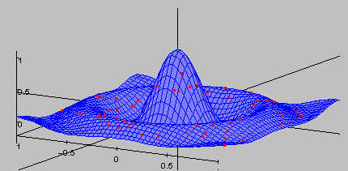
Sample Search Space
A randomly generated population of individuals will be randomly distributed throughout the search space

Slide 43
What is Search Space?
The space of all feasible solutions is called search space (state space)
Each point in the search space represents one feasible solution
Each feasible solution can be “marked” by its value or fitness for the problem
We are looking for our solution, which is one point (or more) among feasible solutions

Slide 44
TSP: An Example
Consider 4 cities a, b, c and d. A salesman needs to visit all 4 cities and return home to city a.
In which order should he/she visit the cities in such a way that the total distance is minimised?
All possible configurations have to be considered to find the optimal solution. For our example the possible solutions are:
a, b, c, d | a, b, d, c | a, c, d, b
a, d, b, c | a, d, c, b | a, c, b, d
As we can see for N cities there are (N -1)! possible configurations.

Slide 45
TSP: An Example (cont)
When N is small (like in our example) its very easy to find the optimal solution. However, when N becomes large the need for a computer becomes useful!
If we assume a computer can evaluate 10¹⁰ configurations in 1 second, how long would it take to evaluate all the possible solutions of N?

Slide 46
TSP: An Example (cont)
Number of time taken to evaluate all
Cities Configurations
16 130 Secs
17 0.58 Hrs
18 9.8 Hrs
20 140 Days
25 1,967,428 Yrs

Slide 47
Now We See The Problem!!!
Nearly 2m years for just 25 cities! This exponential growth in computation time makes enumeration of all possible solutions a non-starter.
Is there a method of finding a good sub-optimal solution?

Slide 48
Genetic Algorithm(s)
Genetic Algorithms are good at
taking large, potentially huge
search spaces and navigating
them, looking for optimal
combinations of things, solutions
you might not otherwise find in a
lifetime.
Genetic algorithms (GA) are a
computational paradigm inspired
by the mechanics of natural
evolution, including survival of the fittest, reproduction, and mutation.

Slide 49
Genetic Algorithm
Developed by John Holland, University of Michigan (1970’s)
Early names: J. Holland, K. DeJong, D. Goldberg

Slide 50
GA Roots
Based on concepts from biology, especially evolution (natural selection and genetics).
Variables are represented as genes on a chromosome e.g. 10101001.
GAs feature a group of candidate solutions (population) on the response surface. Through natural selection and the genetic operators, mutation and recombination, chromosomes with better fitness are found.
Probabilistic search method based on the mechanics of Darwin’s natural selection

Slide 51
The Biology of Genetics
Members of same species share similar sets of genes.
Two members of the same species mate to recombine specific areas of their chromosomes into a new genotype.
Phenotype is solution given by the genotype - Phenotypes will survive based on their fitness for the environment. Fit individuals are more likely to produce offspring than less fit individuals (natural selection).
Over time less beneficial genes are eliminated from gene pool

Slide 52
Genetic Algorithms (GAs)
GAs are inspired by living nature.
Evolution of species is driven by natural selection and the genetic operators of mutation,reproduction and inversion. All of which can be considered a parallel search process.
Perhaps we can tackle hard combinatoric search problems by mimicking the natural processes of evolutionary search.

Slide 53
Genetic Algorithms: Motivation
Evolution is, a method of searching for “solutions”. Organisms well able to survive and reproduce in their environment.
GAs are easily parallelized.
GAs are based on a robust method for adaptation within biological systems.
A simulated population of randomly selected individuals is generated then allowed to evolve.

Slide 54
Motivation
Inspired by evolution in living organisms
“Survival of the fittest”
“Fitter” individuals in the population preferred to reproduce to create new generation

Slide 55
Other algorithms inspired by nature
Neural networks – neurons in brain
Simulated annealing – physical properties of metals
GA, NN have partly overlapped application areas – pattern recognition, ML, image processing, expert systems

Slide 56
GAs: Representation of the Problem
The term chromosome is used to describe a legal solution to the problem. It is composed of a string of genes.
In GA literature chromosomes are usually represented by a string of bits e.g. 101011.
Each bit is effectively a gene.

Slide 57
GAs: Initial Population
Once a representation has been decided it is then necessary to create an initial population with which to begin the search.
This can be created randomly or use some specific information.

Slide 58
Introduction
Population of individuals
  Individual is feasible solution to problem
Based on their fitness, parents are selected to reproduce offspring for a new generation
  New generation has same size as old generation; old generation dies
Offspring has combination of properties of two parents
If well designed, population will converge to optimal solution

Slide 59
Biological Background
Chromosomes: - a candidate solution to a problem, often encoded as a bit string. Serves as model for the organism.
Genes: - Within the chromosomes are individual genes. Each gene encodes a particular protein thereby encodes a specific feature of the individual, that encode a particular element of the candidate solution
Trait: - Each gene encodes a trait. For example, a person's eye colour is dictated by a specific gene.
Alleles: - An allele is a bit sting is either 0 or 1; Possible settings for a trait (e.g. blue, brown).

Slide 60
Population
population
Chromosomes could be:
  Bit strings (0101 ... 1100)
  Real numbers (43.2 -33.1 ... 0.0 89.2)
  Permutations of element (E11 E3 E7 ... E1 E15)
  Lists of rules (R1 R2 R3 ... R22 R23)
  Program elements (genetic programming)
  ... any data structure ...

Slide 61
Concepts of GAs
Each gene represents some parameter of the solution state and the allele is the assigned value for that entry
A population is formed from multiple chromosomes
A generation is created by initializing a single population (usually random values)
The members of the population are evaluated by a fitness function
Chromosomes with the highest fitness are allowed to reproduce to create the next generation of solutions through crossover and mutation
This process of reproduction is continued until some stopping condition is met

Slide 62
Genetic Algorithm
Genetic Algorithms examine biological computation with multiple goals, scientific understanding and potential application among them.
As we look around us; we see many wonders in nature. Creatures can repair themselves, guide themselves, reproduce themselves with a robustness.

Slide 63
Genetic Algorithm
GA technique differs from traditional algorithm development in that a solution ``grows'' rather than being designed by someone.
This typically means that we can't necessarily understand the solution that the process generates.

Slide 64
Genetic Algorithm
In addition, GA have been used in many other innovative ways, for instance, creating new indicators based on existing ones, selecting good indicators, to evolve optimal trading systems and to complement other techniques such as fuzzy logic.
There are four stages in the genetic search process: initialization, evaluation and selection, crossover and mutation.

Slide 65
Genetic Algorithm
In the initialization stage, a population of genetic structures which are randomly distributed in the solution space is selected as the starting point of the search.
In the second stage, each structure is evaluated using a fitness function and assigned a fitness value.
On the basis of their relative fitness values, structures in the current population are selected for reproduction.

Slide 66
Genetic Algorithm
The selected structures are recombined using crossover, with two complementary search functions.
First, it provides new points for further testing of structures already present in the population; Secondly, it introduces instances of new structures into the population.
A mutation operator, which arbitrarily alters one or more components of a selected structure, provides the means for introducing new information into the population.

Slide 67
Continue…
Fitness – The measure of goodness of a solution. (e.g. the function value of a solution in an optimization problem).
Selection – The Darwinian selection mechanism to eliminate bad solutions in a population.
Population – A pool of solutions represented as binary strings (chromosomes) that undergo
-- crossover (mutually among themselves randomly)
-- mutation (randomly)
Note – crossover and mutation destroy old solutions
Elitism – Some elite (good) solutions are carried onto the next generation without being destroyed. It is considered to be a good strategy.

Slide 68
Basic Steps
Coding the problem
Determining “fitness”
Selection of parents for reproduction
Recombination to produce new generation

Slide 69
Design Issues
Goldberg’s principles of coding (building block hypothesis):
  Related genes should be close together
  Little interaction between genes
Is it possible, (and if yes, how) to find coding schemes that obey the principles?
If not, can the GA be modified to improve its performance in these circumstances?

Slide 70
Determining fitness
Fitness function
Varies from problem to problem
Usually returns a value that we want to optimize
Example: Strength / Weight ratio in a civil engineering problem
Unimodal / Multimodal fitness functions – Multimodal: several peaks

Slide 71
Fitness Function
Purpose
Parent selection (test our chromosomes for suitability.)
Measure for convergence
Should reflect the value of the chromosome in some “real” way
Next to coding the most critical part of a GA
Depending on the problem we can either maximise or minimize this function. e.g. For the TSP we want to minimize the distance travelled.

Slide 72
GA key concepts and mechanisms
Based on the concepts of “survival of the fittest”
Solutions are encoded in chromosomes
A population is formed from multiple chromosomes
The members of the population are evaluated by a fitness function
Chromosomes with the highest fitness are allowed to reproduce
Focus is rather on adaptation to the environment than just learning

Slide 73
Selection – Roulette Wheel
Want to maintain an element of randomness but ‘fix’ the selection so that fitter individuals have better odds of being chosen.
Assign areas on a number line relative to each individuals fitness.
Generate a random number within the range of the number line.
Determine which individual occupies that area of the number line.
Choose that individual.

Slide 74
Roulette Wheel Selection –Example
Chromosome # Fitness
1 15.3089
2 15.4091
3 4.8363
4 12.3975
4
3
2
1
Spin
2
1
2
4
Mating Pool

Slide 75
GAs: Selection
Chromosomes are selected from the population for reproduction.
Based on Darwinian evolution. Thus, the fitness of an individual is proportional to the probability that it will reproduce effectively.
Hence, selection is based on fitness. The higher an individual’s fitness, the more chance it has of being selected.

Slide 76
Definition and Process
Genetic algorithm: an iterative procedure maintaining a population of structures that are candidate solutions to specific domain challenges. The viability of each chromosome is measured with a fitness function.
Each candidate solution is called a chromosome
Chromosomes can copy themselves, mate, mutate
Use specific genetic operators - reproduction, crossover and mutation.
Each algorithmic iteration produces a new generation

Slide 77
Genetic algorithm
Solutions “evolve”, via trial and error
Suitable for very complex applications
Consists of population, individuals, chromosome strings, genes, and a fitness function to define application characteristics

Slide 78
Selection
Individuals selected to recombine and produce offspring
Selection of parents based on “Roulette Wheel” algorithm
Fitter parents may get selected multiple times, not-so-fit may not get selected at all
Child can be less fit than parents, but such a child will probably “die out” without reproducing in the next generation.

Slide 79
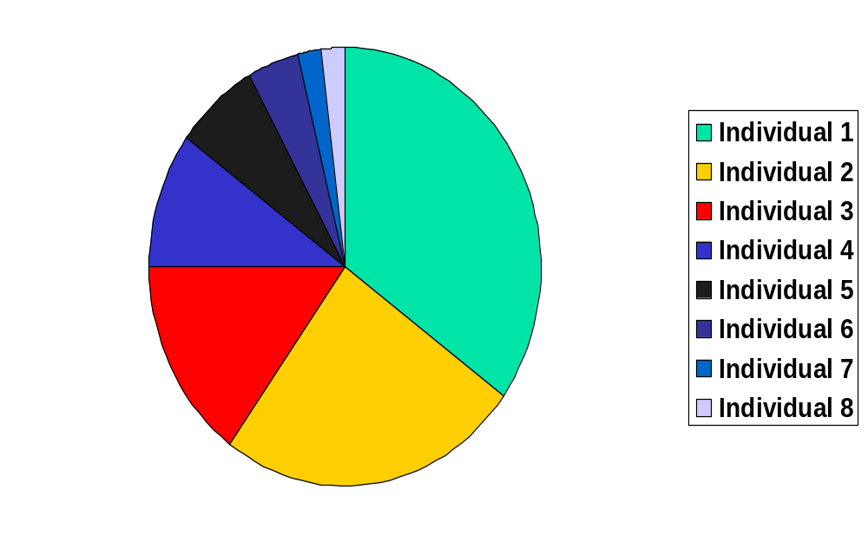
Roulette Wheel selection

Slide 80
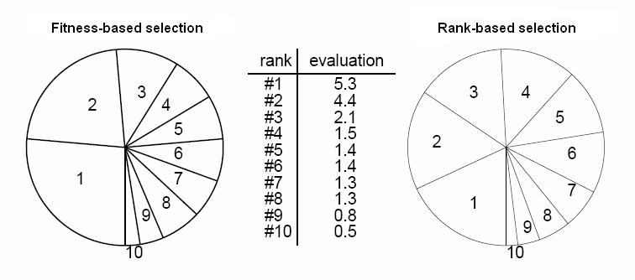
Selection - variations
Fitness-based v/s rank-based

Slide 81
Terminology
Begin with a population of individuals. Each individual represents a solution to the problem we are trying to solve.
A data structure describes the genetic structure of the individual. (Assume this is a string of 0’s and 1’s).
In genetics, the strings are called chromosomes and the bits are called genes.
The string associated with each individual is its genotype
Selection is based on fitness of individuals

Slide 82
The Genetic Algorithm
Each evolving population of individuals is called a generation.
Given a population of individuals corresponding to one generation, the algorithm simulates natural selection and reproduction in order to obtain the next generation.
System learns to adapt to changes.

Slide 83
Three basic operations
Reproduction:
  Individuals from one generation are selected for the next generation
Crossover:
  Genetic material from one individual is exchanged with genetic material from another individual
Mutation:
  Genetic material is altered

Slide 84
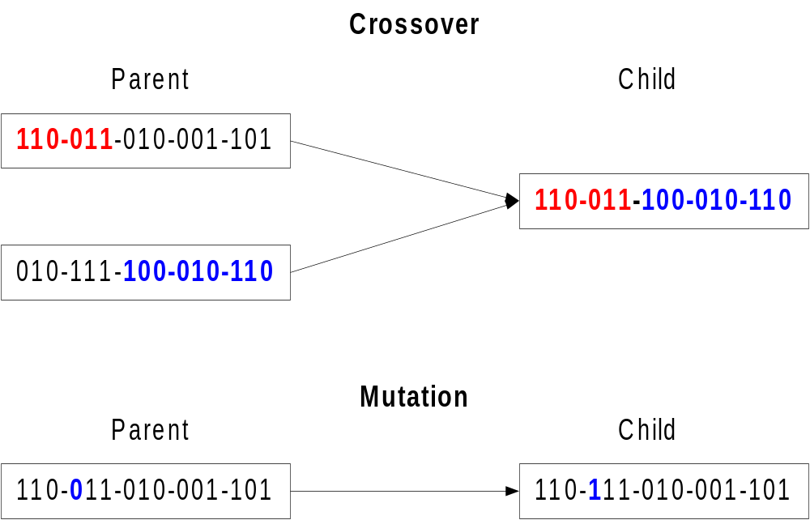
Genetic Algorithm

Slide 85
Parameters of GA
Crossover Probability
Mutation Probability
Population Size
Number of Generations

Slide 86
Example of General GA Procedure
Selection, crossover, and mutation operations
Generation n
13
11
4
9
1 1 0 1
1 0 1 1
0 1 0 0
1 0 0 1
Reproduction
1 1 0 1
1 0 1 1
1 0 1 1
1 0 0 1
Crossover
1
0 1 1
1
1 0 1
1 0
0 1
1 0 0 1
1 1
Mutation
1
0 11
0
1 0 1
1 0 1 1
0 0
1 0 0 1
1 1
Generation n+ 1
11
5
8
11

Slide 87
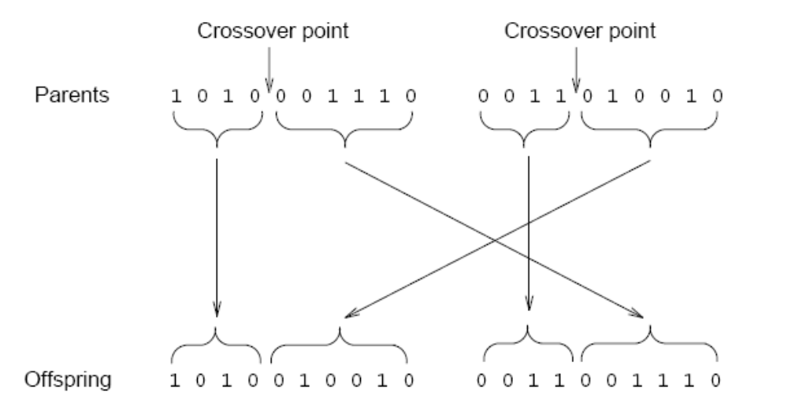
Recombination - Crossover
Crossover probability (typically 0.6 < CP < 1)
If no crossover, child is identical to parent

Slide 88
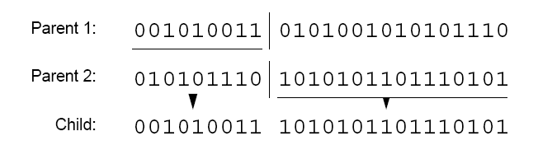
Crossover – variations (1)
One-point crossover

Slide 89
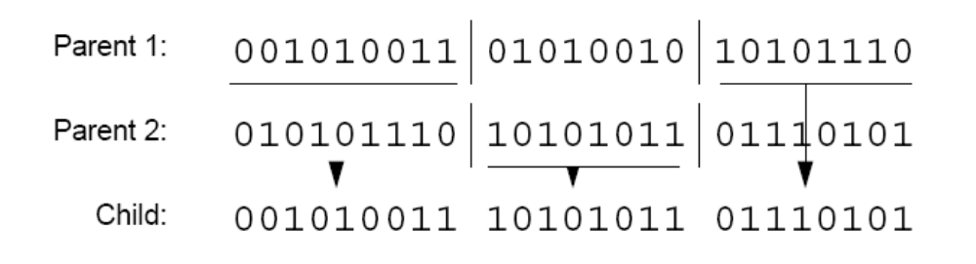
Crossover – variations (2)
Two-point crossover

Slide 90
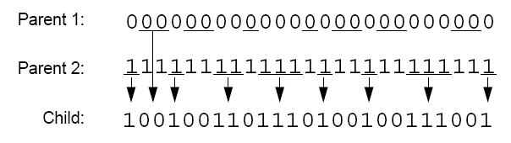
Crossover – variations (3)
Uniform crossover

Slide 91
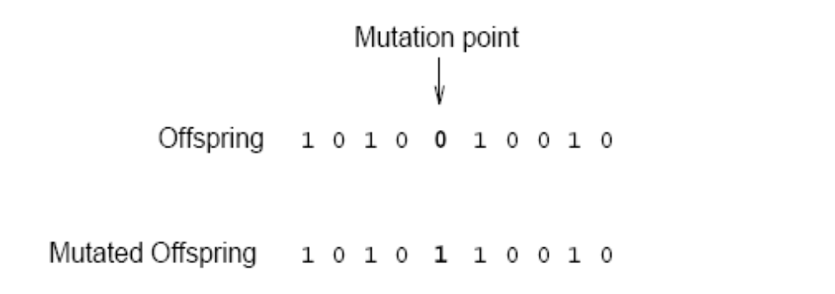
Recombination - Mutation
Crossover – rapidly searches a large problem space
Mutation – allows more fine-grained search

Slide 92
Convergence
Gene convergence: when 95% of the population has the same value for that gene
Population convergence: when all the genes reach convergence

Slide 93
Outline of the Basic Genetic Algorithm
[Start] Generate random population of n chromosomes (suitable solutions for the problem)
[Fitness] Evaluate the fitness f(x) of each chromosome x in the population
[New population] Create a new population by repeating following steps until the new population is complete

Slide 94
Outline of the Basic Genetic Algorithm
[Selection] Select two parent chromosomes
from a population according to their fitness (the better fitness, the bigger chance to be selected) The idea is to choose the better parents.
[Crossover] With a crossover probability cross over the parents to form a new offspring (children). If no crossover was performed, offspring is an exact copy of parents.
[Mutation] With a mutation probability mutate new offspring at each locus (position in chromosome).

Slide 95
Outline of the Basic Genetic Algorithm
[Accepting] Place new offspring in a new
population
[Replace] Use new generated population for a further run of algorithm
[Test] If the end condition is satisfied, stop, and return the best solution in current population
[Loop] Go to step 2

Slide 96
Coding
GA in nature | GA in CS
Genes | Parameters of solution
Chromosome = collection of genes | Chromosome = concatenated parameter values
Genotype = set of parameters represented in the chromosome
Phenotype = Finished “construction” of the individual (values assigned to parameters)

Slide 97
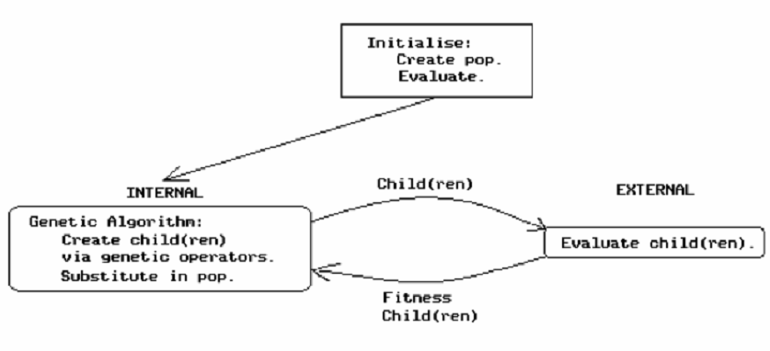
Generic Model for
Genetic Algorithm (1)

Slide 98
Generic Model for
Genetic Algorithm (2)
BEGIN /* genetic algorithm */
generate initial population
WHILE NOT finished DO
BEGIN
compute fitness of each individual
IF population has converged THEN
finished := TRUE
ELSE
  /* reproductive cycle */
  apply genetic operators to produce children
END
END
END

Slide 99
Components of a GA
A problem to solve, and ...
Encoding technique (gene, chromosome)
Initialization procedure (creation)
Evaluation function (environment)
Selection of parents (reproduction)
Genetic operators (mutation, recombination)
Parameter settings (practice and art)

Slide 100
Simple Genetic Algorithm
{
  initialize population;
  evaluate population;
  while TerminationCriteriaNotSatisfied
  {
    select parents for reproduction;
    perform recombination and mutation;
    evaluate population;
  }
}

Slide 101
Algorithm of standard GA
40
100
30
70
Create initial
population
Calculate
fitness
Select parents
Create children

Slide 102
Architecture of the Genetic Algorithm
Data
Best solution found so fare
Initialization
Initial Population
Evaluate Chromosomes
Evaluated Population
Next Generation
Select Chromosomes
Mutate Chromosomes
Candidate Next Generation
Candidate Next Generation
Crossover Chromosomes

Slide 103
The GA Cycle of Reproduction
children
reproduction
modification
modified
children
parents
population
evaluation
evaluated children
deleted
members
discard

Slide 104
Reproduction
children
reproduction
parents
population
Parents are selected at random with selection chances biased in relation to chromosome evaluations.

Slide 105
Chromosome Modification
Modifications are stochastically triggered
Operator types are:
  Mutation
  Crossover (recombination)
children
modification
modified children

Slide 106
Operators and Definitions
In binary GA s crossover is performed by swapping a part of binary strings between two solutions at a randomly chosen cross-site with some probability. It is a binary operator.
Crossover is a critical feature
It greatly accelerates search early in evolution of a population
  It leads to effective combination of schemata (subsolutions on different chromosomes)

Slide 107
Mutation
Mutation – Conversion of proteins from one to another.
In Binary GA , mutation is performed by converting some random bit of a binary string into its complementary bit (ie a 1 to a 0 or vice versa) with some probability. It is a unary operator.
Mutation will help prevent the population from stagnating. It adds “fresh blood” to a population of solutions to a problem. It adds diversity.

Slide 108
Genetic operators for the creation of children
Crossover: portions of strings of the two parents are exchanged
Mutation: the value of one bit (gene) is changed at random
Permutation: the order of a portion of the chromosome is reversed
Addition/deletion: one gene is added to/removed from the chromosome

Slide 109
Evaluation
The evaluator decodes a chromosome and assigns it a fitness measure
The evaluator is the only link between a classical GA and the problem it is solving
modified
children
evaluated
children
evaluation

Slide 110
Deletion
population
Generational GA:
entire populations replaced with each iteration
Steady-state GA:
a few members replaced each generation
discarded members
discard

Slide 111
Mutation: Local Modification
Before: (1 0 1 1 0 1 1 0)
After: (0 1 1 0 0 1 1 0)
Before: (1.38 -69.4 326.44 0.1)
After: (1.38 -67.5 326.44 0.1)
Causes movement in the search space
(local or global)
Restores lost information to the population

Slide 112
Analysis of GA
the algorithm is started on a problem, runs for a preset number of generations/iterations or until some termination condition is met, and the current best solution or solutions examined.
The examination provides a ranking of current solutions, if there are more than one.

Slide 113
Analysis continue…
The sequence of generated solutions (history) provides information on what the algorithm considers important in coming up with the current solution set.
When combined with knowledge about a particular algorithm's assumptions about search spaces, the algorithms history can furnish a designer with information needed to answer questions about a solution.

Slide 114
Analysis continue…
Analysis of the building blocks and the path taken by a GA through a search space provides a powerful mechanism for explaining the solutions generated by a GA
Results of the explanation can be used to guide post-processing in order to improve results in case of premature convergence

Slide 115
Analysis continue…
Start at identifying, extracting, organizing, and storing domain knowledge garnered while searching in a poorly-understood domain.
During the course of future searches, this knowledge can be used and added to, tuning the algorithm for this particular space.

Slide 116
Analysis continue…
Genetic or other blind search algorithms can be used as explorers of poorly understood domains, with the side effect of inducing a domain model during the course of search.
Initially, in such a system, there would be little knowledge and much searching. With increasing knowledge, in subsequent searches, the population of a genetic algorithm would be seeded with individuals hypothesized to be close to the required solution

Slide 117
Analysis continue…
Combining fitness prediction with hamming average prediction indicates how much progress is possible with a GA along with bounds on how much remaining work can be done.
The predicted average fitness indicates how much progress is possible, but it is the predicted hamming average that denotes the remaining work

Slide 118
Overview of Performance
So, even after one iteration, with no knowledge except for the relative fitness value, the GA has begun to quickly converge on the optimum value.
Considering the GA knows nothing about the problem space in which it searches. It is effectively blind.

Slide 119
Overview of Performance
Yet, just by examining a measure of goodness, having a large number of points to examine simultaneously and having a large amount of randomization thrown in, the GA efficiently searches the problem space for possible answers.
After couple of iterations we get the correct answer .Hence in this way Genetic Algorithms just help us out in a lot of ways and in many fields.

Slide 120
A Simple Example
The Optimization Problem: -
The problem is simply stated. Maximizing the function
Y = f(X)= X^2

Slide 121
Selecting the Fitness Factor
We just select the fitness factor as: -
Fitness Factor: f_{i} f
We just select the create a random parents as : -
₁₃ ₋ ₀₁₁₀₁
₂₄ ₋ ₁₁₀₀₀
₀ ₈ ₋ ₀₁₀₀₀
₁₉ ₋ ₁₀₀₁₁

Slide 122
Selection
String | X Value | f(x) | Relative Fitness Value | Nr of Selections
01101 | 13 | 169 | 0.14 | 1
11000 | 24 | 576 | 0.49 | 2
01000 | 8 | 64 | 0.06 | 0
10011 | 19 | 361 | 0.31 | 1
Sum |  | 1170 | 1.0 | 4

Slide 123
Selection(Contd.)
String Population
11000
10011
11000
01101

Slide 124
Crossing Over
Mating Pool Strings | New Population
0110|1 1100|0 | 01100 11001
10|011 01|101 | 10101 01011

Slide 125
Final Mating Pool
String Population | x Value
01100 | 12
11001 | 25
10101 | 21
01011 | 11

Slide 126
Crossover
One-point crossover
Two-point crossover
Uniform crossover

Slide 127
Parameters to Set
Number of initial solutions to generate
Number of offspring to generate
Number of parents and offspring to keep for the next generation
Mutation probability (very low)
Probability distribution of crossover point occurrence
Parameters depend on problem being solved
Determined by trial and error

Slide 128
The power of GAs
It is the fitnesses that drive the evolution
A GA can evolve a system of enormous complexity, well beyond what a human being can conceive of or design.
This greater complexity can often lead to performance levels beyond what human engineers are capable of.

Slide 129
Keys to the success of a GA
1.Data structures for
Genes
Chromosomes
Population
2.Fitness evaluation function
3. An excellent collection of training data

Slide 130
Genetic Algorithm: Why does it work?
Children carry parts of their parents’ data
Only “good” parents can reproduce
Children are at least as “good” as parents?
No, but “worse” children don’t last long
Large population allows many “current points” in search
Can consider several regions at once

Slide 131
GAs-Randomized Search
GAs are not simply random search algorithms, Random search algorithms can be inherently inefficient due to the directionless nature of their search.
GAs are not directionless.
They use past knowledge to direct the search

Slide 132
Why the GA is interesting
Does not require any knowledge of how to get a solution for the problem to be solved.
Advantage to provide near-optimal solutions to problems that do not have an algorithmical solution.
The genetic algorithm is also easy to put to use: the "engine" is shared; there is little problem-specific code to write.

Slide 133
Issues for Genetic Algorithms
Choosing basic implementation issues:
  representation
  population size, mutation rate, ...
  selection, deletion policies
  crossover, mutation operators
Termination Criteria
Performance, scalability
Solution is only as good as the evaluation function (often hardest part)

Slide 134
Benefits of Genetic Algorithms
Concept is easy to understand
Modular, separate from application
Supports multi-objective optimization
Good for “noisy” environments
Always an answer; answer gets better with time
Inherently parallel; easily distributed
Easily exploit previous or alternate solutions

Slide 135
Benefits of Genetic Algorithms (cont.)
Many ways to speed up and improve a GA-based application as knowledge about problem domain is gained
Easy to exploit previous or alternate solutions
Flexible building blocks for hybrid applications
Substantial history and range of use
Evolutionary technique … adaptive to changes

Slide 136
GA - Plus points
Robust: Wide range of problems can be tackled
“Acceptably good” solutions in “acceptably quick” time
Explore wide range of solution space reasonably quickly
Combination of Exploration and Exploitation
Hybridizing existing algorithms with GAs often proves beneficial

Slide 137
GA - shortcomings
Need not always give a globally optimum solution!
Probabilistic behaviour

Slide 138
Disadvantages
Require large number of response (fitness) function evaluations.
Configuration is not straightforward.
Have trouble finding the exact global optimum.
These can be slower than other techniques due to computational time.
The GA can generate some chromosomes that do not represent valid solutions.

Slide 139
Limitations
For large problems, memory requirement is high.
Not exact result every time, so multiple runs required
No comparative good results, when specific heuristics available.

Slide 140
Genetic algorithms and other search procedures
GAs work with a coding of the parameter set, not the parameters themselves.
GA search from a population of points, not a single point.
Gas use payoff (objective function) information, not derivatives or other auxiliary knowledge.
GAs use probabilistic transition rules, not deterministic rules.

Slide 141
The Robustness of the GA
Problem independent nature due to encoding of the solution rather then working directly on solution.
Parallel work on solutions rather then search by single solution so as to up gradation of whole population and thus finding Global minima rather then local minima.
Self-repair and Self-guidance

Slide 142
When to Use a GA
Alternate solutions are too slow or overly complicated.
Need an exploratory tool to examine new approaches.
Want to hybridize with an existing solution.
Benefits of the GA technology meet key problem requirements.
No mathematical analysis is available.
Traditional search methods fail.
Domain knowledge is scarce or expert knowledge is difficult to encode to narrow the search space.

Slide 143
GAs: What We Need?
Decide what constitutes a viable part of a solution (what are our genes?).
Decide how to determine fitness of a solution.
A method to select chromosomes from population for mating or mutation.
Decide on a data structure to represent the chromosome.
Choose a technique to mutate the chromosome & to enable crossover.
Choose a technique to reinsert children into population

Slide 144
Experimenting With Genetic Algorithms
Be sure you have a reasonable “goodness” criterion
Choose a good representation (including methods for crossover and mutation)
Generate a sufficiently random, large enough population
Run the algorithm “long enough” & Find the “winners” among the population

Slide 145
Randomized Algorithms
Guided random search technique
Uses the payoff function to guide search
Genetic Algorithms (GAs)
GA
Efficiency
Specialized Algo.
Problems
P
Specialized algorithms – best performance for special problems
Genetic algorithms – good performance over a wide range of problems

Slide 146
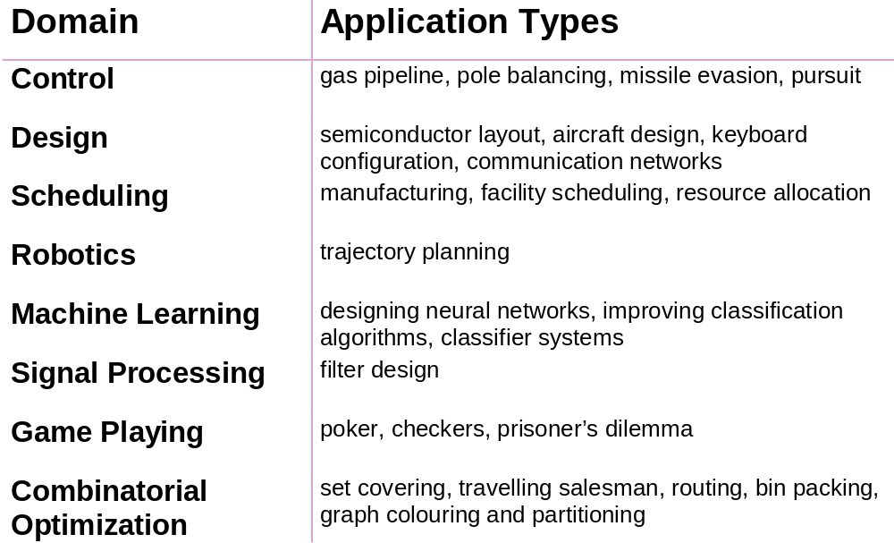
Some GA Application Types

Slide 147
When GAs applied to very large problems, they fail in two aspects
They scale rather poorly (in terms of time complexity)
The solution quality degrades rapidly.

Slide 148

Summary
Are global optimization methods
Biologically inspired
Find global optima without relying on gradients
Are robust and often provide surprisingly good results fast
Useful for optimizing highly complex cost functions with large numbers of parameters
Require very little information about a problem
Useful for problems that involve searching parameter spaces in which there are many local minima
Only a cost function is required, no derivatives
Ideal parallel search procedure

Slide 149
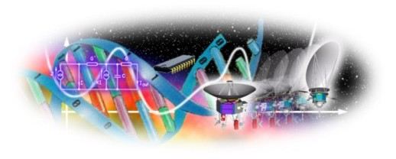
Conclusions
Genetic algorithm - an artificial intelligence system that mimics the evolutionary, survival-of-the-fittest process to generate increasingly better solutions to a problem.
‘Genetic algorithms are rich - rich in application across a large and growing number of disciplines.’

Slide 150
Thank You…

